Slide 1
What is Progressive Enhancement?
Written by Michael “Spell” Spellacy
Presented by Larry Viezel

Slide 2
User Interface Development Overview
Web User Interface Development is the skill of creating content and visual controls that can be delivered to an end-user in a functional and accessible manner.
The field of user interface development concentrates on the following:
Usability – The front-end construction of all web sites is about more than just writing “simple” HTML mark-up, it’s about bringing the work of great management, information design, writing, and creative to life within the browsing device and about creating a usable experience for all visitors to enjoy (and hopefully return to). Usability refers to the study of the principles behind an object’s perceived efficiency or elegance. The UI developer must put careful thought into the usability of a web site and how the end-user will interact with the page they are viewing.
Accessibility – Usability then naturally leads to accessibility. Not just for the blind or the deaf (a popular misconception when the word “accessible” is used), but accessibility for everyone! How will the site render on mobile devices? Will it work without the aid of JavaScript? Will using Flash on your site be a problem for iPad users (Yes)? All of these questions, and many more, fall under accessibility. At TMP we strive to make sure our sites are as user friendly and as accessible as can possibly be.
Standards – The web has changed drastically since the dark days of browser wars and fly by the seat of your pants web development. The industry is now maturing. This is due in large part to the advent and adoption of web standards. Building with web standards is equivalent to making sure you pour the foundation before building the house. A good User Interface developer or designer must adhere to these rules as closely as possible when writing the underlying code for a web site. Web sites built with standards are also generally more accessible and much easier to maintain.
Progressive Enhancement – Web sites are no longer tied to browsers on our desktops. With the arrival of the mobile web and access to web sites on many different devices it is now more important than ever to make sure our web sites are reaching as wide an audience as possible. Progressive Enhancement (PE) is the key to making this happen. By building a strong foundation and layering in design and functionality intelligently, we can ensure that our message is being received by many users.
TMP Worldwide. The Digital Brand Authority.
Notes:
Let’s first start with an overview of User Interface Development and then dig into the topic of today – Progressive Enhancement.

Slide 3
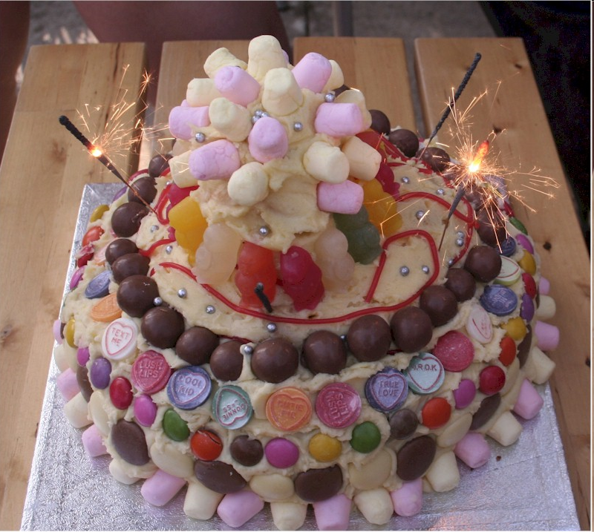
Tools/Techniques
Coding with Web Standards
The three user interface layers of a website:
HTML (Hypertext Mark-up Language) – The Structural Layer
CSS (Cascading Style sheets) – The Presentation Layer
JavaScript – The Behavioural Layer
TMP Worldwide. The Digital Brand Authority.
Notes:
Before we jump in, let’s present a more simplified view of UI development for the non-technical readers in the audience. Simply put, Web User Interface development can be compared to making a birthday cake. That may sound odd, but it really is just like that. First, you have the most important part, the cake itself, which defines the base structure of our sites. In our case, this is the HTML, in which no site can exist without. Then come the icing and sprinkles (and don’t forget those yummy flowers). This is the look and feel of the site, the presentation layer defined in the CSS. And last, but certainly not least, are the sparklers (or stick of dynamite if you are not careful); the behavioral layer, which is the JavaScript that gives your site its functional pizzazz. All three technologies, kept separated from each other, but delivered together to create the entire site experience. This, in essence, is what modern day interface development is all about. Once you grasp this concept, you’ll understand what it takes to develop rock solid, powerful and accessible user interfaces. Are you hungry for more? Read on!

Slide 4
What is Progressive Enhancement?
Progressive enhancement (or “PE” for short) is a web development strategy used to build sites with baseline devices in mind while layering in a richer experience for users with more modern browsers.
http://dowebsitesneedtolookexactlythesameineverybrowser.com/
Notes:
Progressive Enhancement is a broad topic but to simplify the subject, it is basically a strategy for layering in enhancements and functionality to a page without the core message of the page being lost in older or less capable browsers.
On today’s web we need to be worrying less about pixel perfect page aesthetics and more about the content and message we are trying to convey to the end user. This is not to say that design and branding are not important, they are (we are an advertising agency after all) but when it comes to development we typically pull out all of the bells and whistles for the more modern browsers while allowing the site to degrade gracefully on older user agents. For example, with CSS3 we can easily add drop shadows to elements on a web page. Internet Explorer 6 or 7 does not support CSS3 and will therefore not render a drop shadow (In most cases the users of IE 6 or 7 won’t even know what they are missing). All web pages do not have to look exactly the same across different browsers, but if you need to explain this in a way a client can understand then just tell them that this method is a widely acceptable, maintenance friendly and cost effective way of developing.

Slide 5
But isn't that the same as Graceful Degradation?
Not quite. Graceful Degradation, also known as "fault tolerance“, allows a website to degrade in such a way that it continues to operate, but provides a reduced level of service rather than failing completely. (Examples of this are those pesky “You must have JavaScript or Flash support for this to work” messages.)
Progressive enhancement takes a different approach to development in that it seeks to create websites that are universally accessible to all by placing heavy emphasis on content and structure first and then building upon that in layers so that if one of those layers, like JavaScript, should fail, the site will still be accessible.
Notes:
Graceful Degradation: Examples of this are those pesky “You must have JavaScript or Flash support for this to work” messages.

Slide 6
So how do we “progressively enhance” a website?
Separation of HTML, CSS and JavaScript are key to
building sites that work for everybody:
Begin with clear and well structured content. HTML is the foundation on which all else will be built.
Maintain rigid separation of layout and presentation with CSS.
Unobtrusively layer in advance behavior while carefully considering accessibility.
Let’s see an example…

Slide 7
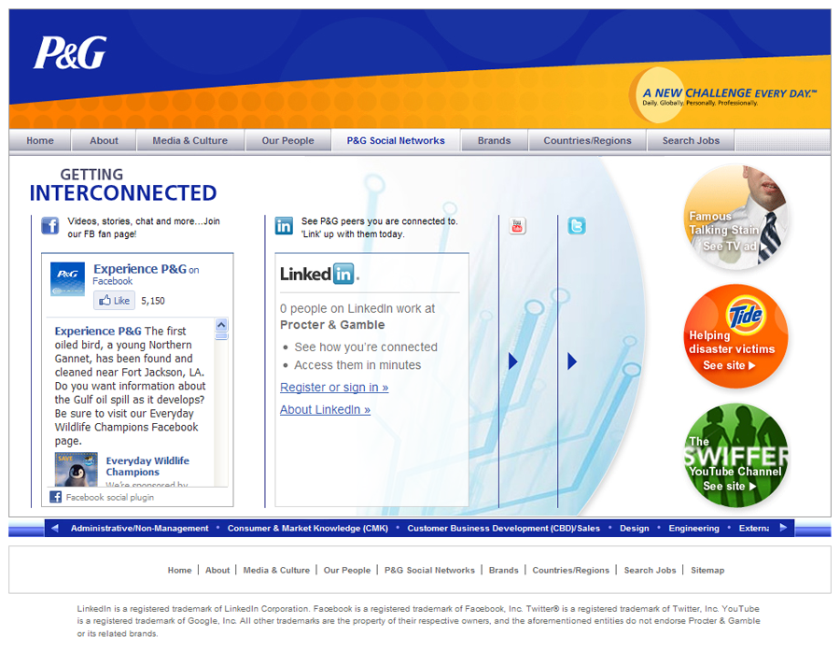
The Advanced Page
Here we have a page for P&G which contains advance JavaScript functionality that allows the end user to “slide” through different social widgets. This page should work well on all modern browsers.

Slide 8
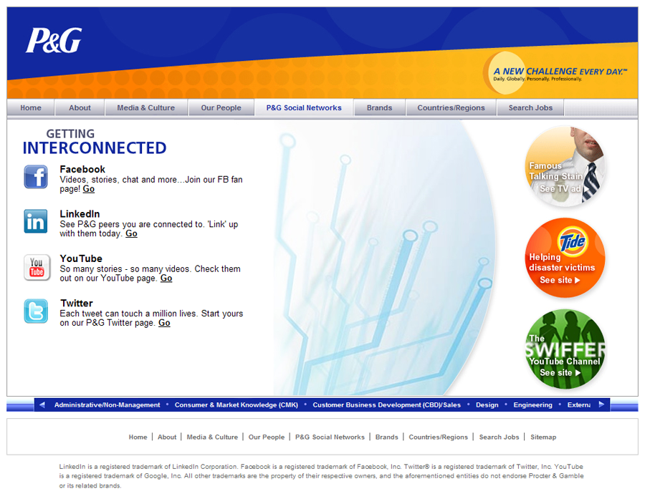
No JavaScript? No Problem!
This is the same exact page with JavaScript turned off. While not as advanced as the previous version, the message of this page is still left intact!

Slide 9
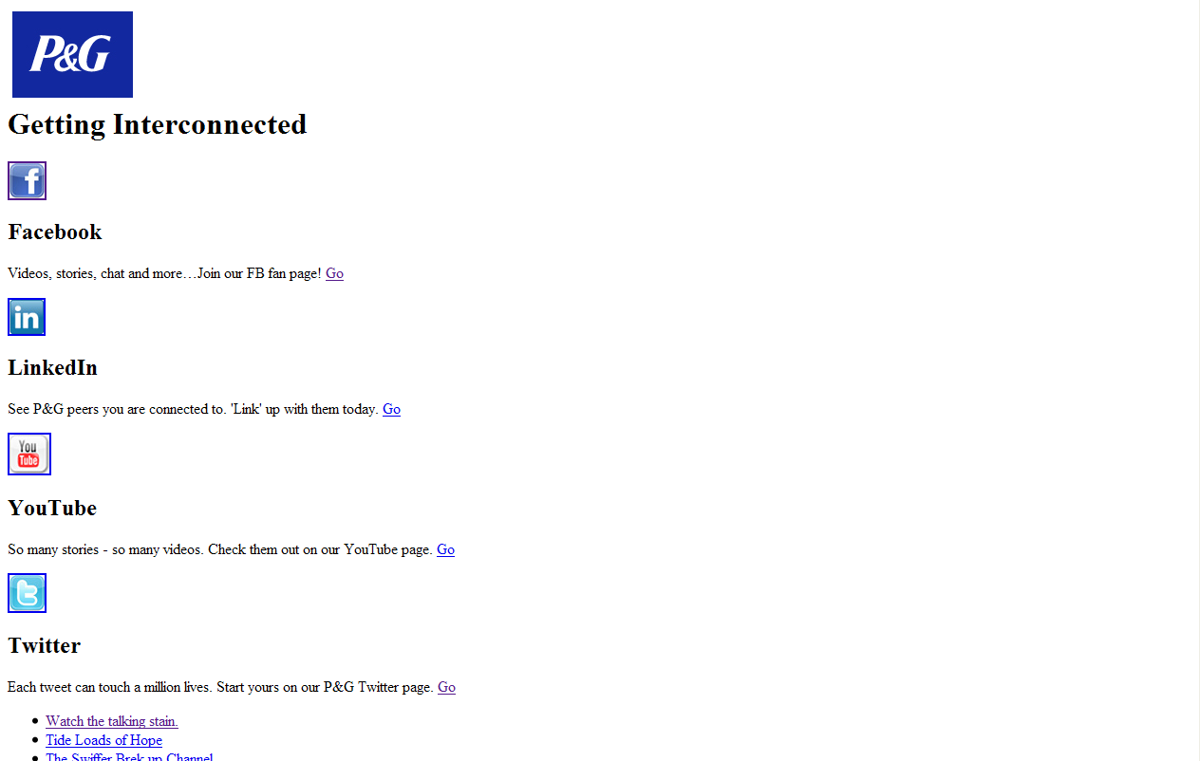
No CSS? No Problem!
We can even take it a step further and view the page without CSS (Perhaps someone with an older mobile device has stumbled upon our page). Because we’ve taken the time to lay a foundation down first with semantically and structurally sound HTML and then build from the ground up the page still retains it’s message! With Progressive Enhancement – everybody wins!**
** Everybody, that is, who still doesn’t insist upon having the same exact pixel perfect cross-browser experience!

Slide 10
Flash Standards
1. Written flash standards are underway and will be distributed this summer
2. Via your PM, talk to Flash Developer at onset of project to determine if Flash is appropriate solution.
3. See next few slides for details on Asset Requirements for Flash projects
Notes:
Asset Requirements
Before development can begin, assets in the following categories must be received.
Project Manager / IXD
Wireframe outline including all business rules
Required specifications include, but not limited to:
dimensions
player version
testing platforms
accessibility options
third-party external files/links/streams/feeds
progressive enhancement fallback to JavaScript**
progressive enhancement fallback to HTML**
**NOTE: Some type of progressive enhancement (the ability for a webpage unable to display a higher technology, able to fall back to a more accessible standard) is required for all Flash media projects. More information on this process can be found under Standards in the Post-Development section.
Graphic Design
Assets should be received in a layered Photoshop File (.PSD) with appropriate labeling.
Element grouping with SmartObjects is not recommended.
Masked blending modes can not be utilized. A selection of Blending modes can be used on single non-masked layers though:
Normal Applies color normally, with no interaction with the base colors.
Layer Lets you stack movie clips on top of each other without affecting their color.
Darken Replaces only the areas that are lighter than the blend color. Areas darker than the blend color don’t change.
Multiply Multiplies the base color by the blend color, resulting in darker colors.
Lighten Replaces only pixels that are darker than the blend color. Areas lighter than the blend color don’t change.
Screen Multiplies the inverse of the blend color by the base color, resulting in a bleaching effect.
Overlay Multiplies or screens the colors, depending on the base colors.
Hard Light Multiplies or screens the colors, depending on the blend mode color. The effect is similar to shining a spot light on the object.
Difference Subtracts either the blend color from the base color or the base color from the blend color, depending on which has the greater brightness value. The effect is similar to a color negative.
Add Commonly used to create an animated lightening dissolve effect between two images.
Subtract Commonly used to create an animated darkening dissolve effect between two images.
Invert Inverts the base color.
Alpha Applies an alpha mask.
Erase Removes all base color pixels, including those in the background image.
Design should not exceed 1004 pixels in width.
Exact dimensions need to be specified! SWF container HTML scaling will not be allowed.
Copy should be included in .PSD. Developers are robots; What you give them is what goes online.
Non web-friendly fonts (Helvetica Neue, Futura, etc) must be included.
Be mindful of content areas that receive dynamic images or text, and the spacing around it.
Copy
Copy should be presented in it’s final form and also spellchecked/proofread.
All copy should be included in the PSD design BEFORE handoff to development.
An external file in a rich open format (.RDF) should be included, containing all used text and text options with appropriate styling (bold, italic, underlined, etc).
Updates to copy post handoff to development must adhere to the above rules, including updating design PSD to ensure copy will comply with design limitations.
Sound Design
Audio files should be presented in one of the approved file formats.
Multiple quality grades file of each sound (48KB, 64KB, 128KB).
Audio needs to be cut to any pre-determined lengths set forth in the project’s Wireframe.
Audio files should not include any prefix or suffix inserted silence.
Loops (if not cut or are part of another included sound file) are required to include the start point and end point timecodes written in the file’s property comments.
Video
Video files should be presented in one of the approved file formats below EXCEPT .F4A or .FLV; Flash Development will do the media conversion.
Source video files are recommended to be uncompressed (non-MPEG-4) for the best quality output.
Video needs to be cut to any pre-determined lengths set forth in the project’s Wireframe.
Video loops (if not cut or part of another included video file) are required to include the start point and end point timecodes written in the file’s property comments

Slide 11
Flash Standards
Project Manager / IXD
Wireframe outline including all business rules
Required specifications include, but not limited to:
dimensions
  player version
  testing platforms
  accessibility options
  third-party external files/links/streams/feeds
  progressive enhancement fallback to JavaScript**
  progressive enhancement fallback to HTML**
**NOTE: Some type of progressive enhancement (the ability for a webpage unable to display a higher technology, able to fall back to a more accessible standard) is required for all Flash media projects. More information on this process can be found under Standards in the Post-Development section.
Notes:
Graphic Design
Assets should be received in a layered Photoshop File (.PSD) with appropriate labeling.
Element grouping with SmartObjects is not recommended.
Masked blending modes can not be utilized. A selection of Blending modes can be used on single non-masked layers though:
Normal Applies color normally, with no interaction with the base colors.
Layer Lets you stack movie clips on top of each other without affecting their color.
Darken Replaces only the areas that are lighter than the blend color. Areas darker than the blend color don’t change.
Multiply Multiplies the base color by the blend color, resulting in darker colors.
Lighten Replaces only pixels that are darker than the blend color. Areas lighter than the blend color don’t change.
Screen Multiplies the inverse of the blend color by the base color, resulting in a bleaching effect.
Overlay Multiplies or screens the colors, depending on the base colors.
Hard Light Multiplies or screens the colors, depending on the blend mode color. The effect is similar to shining a spot light on the object.
Difference Subtracts either the blend color from the base color or the base color from the blend color, depending on which has the greater brightness value. The effect is similar to a color negative.
Add Commonly used to create an animated lightening dissolve effect between two images.
Subtract Commonly used to create an animated darkening dissolve effect between two images.
Invert Inverts the base color.
Alpha Applies an alpha mask.
Erase Removes all base color pixels, including those in the background image.
Design should not exceed 1004 pixels in width.
Exact dimensions need to be specified! SWF container HTML scaling will not be allowed.
Copy should be included in .PSD. Developers are robots; What you give them is what goes online.
Non web-friendly fonts (Helvetica Neue, Futura, etc) must be included.
Be mindful of content areas that receive dynamic images or text, and the spacing around it.
Copy
Copy should be presented in it’s final form and also spellchecked/proofread.
All copy should be included in the PSD design BEFORE handoff to development.
An external file in a rich open format (.RDF) should be included, containing all used text and text options with appropriate styling (bold, italic, underlined, etc).
Updates to copy post handoff to development must adhere to the above rules, including updating design PSD to ensure copy will comply with design limitations.
Sound Design
Audio files should be presented in one of the approved file formats.
Multiple quality grades file of each sound (48KB, 64KB, 128KB).
Audio needs to be cut to any pre-determined lengths set forth in the project’s Wireframe.
Audio files should not include any prefix or suffix inserted silence.
Loops (if not cut or are part of another included sound file) are required to include the start point and end point timecodes written in the file’s property comments.
Video
Video files should be presented in one of the approved file formats below EXCEPT .F4A or .FLV; Flash Development will do the media conversion.
Source video files are recommended to be uncompressed (non-MPEG-4) for the best quality output.
Video needs to be cut to any pre-determined lengths set forth in the project’s Wireframe.
Video loops (if not cut or part of another included video file) are required to include the start point and end point timecodes written in the file’s property comments

Slide 12
Flash Standards
Graphic Design
Assets should be received in a layered Photoshop File (.PSD) with appropriate labeling.
Element grouping with SmartObjects is not recommended.
Masked blending modes can not be utilized. A selection of Blending modes can be used on single non-masked layers though:
  Normal Applies color normally, with no interaction with the base colors.
  Layer Lets you stack movie clips on top of each other without affecting their color.
  Darken Replaces only the areas that are lighter than the blend color. Areas darker than the blend color don’t change.
  Multiply Multiplies the base color by the blend color, resulting in darker colors.
  Lighten Replaces only pixels that are darker than the blend color. Areas lighter than the blend color don’t change.
  Screen Multiplies the inverse of the blend color by the base color, resulting in a bleaching effect.
  Overlay Multiplies or screens the colors, depending on the base colors.
  Hard Light Multiplies or screens the colors, depending on the blend mode color. The effect is similar to shining a spot light on the object.
  Difference Subtracts either the blend color from the base color or the base color from the blend color, depending on which has the greater brightness value. The effect is similar to a color negative.
  Add Commonly used to create an animated lightening dissolve effect between two images.
  Subtract Commonly used to create an animated darkening dissolve effect between two images.
  Invert Inverts the base color.
  Alpha Applies an alpha mask.
  Erase Removes all base color pixels, including those in the background image.
Design should not exceed 1004 pixels in width.
Exact dimensions need to be specified! SWF container HTML scaling will not be allowed.
Copy should be included in .PSD. Developers are robots; What you give them is what goes online.
Non web-friendly fonts (Helvetica Neue, Futura, etc) must be included.
Be mindful of content areas that receive dynamic images or text, and the spacing around it.
Copy
Copy should be presented in it’s final form and also spellchecked/proofread.
All copy should be included in the PSD design BEFORE handoff to development.
An external file in a rich open format (.RDF) should be included, containing all used text and text options with appropriate styling (bold, italic, underlined, etc).
Updates to copy post handoff to development must adhere to the above rules, including updating design PSD to ensure copy will comply with design limitations.
Notes:
Sound Design
Audio files should be presented in one of the approved file formats.
Multiple quality grades file of each sound (48KB, 64KB, 128KB).
Audio needs to be cut to any pre-determined lengths set forth in the project’s Wireframe.
Audio files should not include any prefix or suffix inserted silence.
Loops (if not cut or are part of another included sound file) are required to include the start point and end point timecodes written in the file’s property comments.
Video
Video files should be presented in one of the approved file formats below EXCEPT .F4A or .FLV; Flash Development will do the media conversion.
Source video files are recommended to be uncompressed (non-MPEG-4) for the best quality output.
Video needs to be cut to any pre-determined lengths set forth in the project’s Wireframe.
Video loops (if not cut or part of another included video file) are required to include the start point and end point timecodes written in the file’s property comments

Slide 13
Flash Standards
Sound Design
Audio files should be presented in one of the approved file formats.
Multiple quality grades file of each sound (48KB, 64KB, 128KB).
Audio needs to be cut to any pre-determined lengths set forth in the project’s Wireframe.
Audio files should not include any prefix or suffix inserted silence.
Loops (if not cut or are part of another included sound file) are required to include the start point and end point timecodes written in the file’s property comments.
Video
Video files should be presented in one of the approved file formats below EXCEPT .F4A or .FLV; Flash Development will do the media conversion.
Source video files are recommended to be uncompressed (non-MPEG-4) for the best quality output.
Video needs to be cut to any pre-determined lengths set forth in the project’s Wireframe.
Video loops (if not cut or part of another included video file) are required to include the start point and end point timecodes written in the file’s property comments

Slide 14
File Formats
The two tables below show the allowed file formats and prohibited file formats for creation and/or inclusion in TMP Flash Development. Please read the explanations carefully, as they may note specific details of use. If the file format you’re interested in using is not listed below, on a per-project basis, a recommendation can be made for approval.
Allowed File Formats
FLASH SOURCE FILES
.FLA (CS4) This is the default core file FLA’s should be formatted as (CS4), unless special conditions apply. A FLA is required with every Flash IDE project developed and archived.
.FLA (CS5) If a project requires additional resources unavailable in CS4, CS5 formatted .FLAs will be allowed. Approval from the project’s producer is required.
.FLA (CS3) This is the oldest file format that may be utilized if CS4 or CS5 are unavailable. It is not recommended due to insecure compiled code, numerous bugs, and lack of properly updateable ActionScript specifications. This format is also no longer supported by Adobe.
.AS Text-based ActionScript source code file format. A document class file is required with every project developed and archived.
.SWC Shockwave Component file format. Contains source .as and .swf files for code extensions and/or UI interface in a read-only format. TMP supports the use of .SWC files, but not the creation for internal library or public use.
.SWF Shockwave file produced from a Flash/Flex IDE publish. This is the only flash format allowed for release to production. This format may also be used as an external asset.
.MXML Mark-up language styled syntax for GUI development in Flash Builder. Must receive approval first before use in project creation.
DATA FILES
.XML Extendable Mark-up Language file format for delivering external data. These can be static or generated with proper headers through server-side scripting.
JSON (.TXT) JavaScript Object Notation text-based file format for delivering external data. These are usually generated server-side scripting. Should only be used if XML is unavailable.
AUDIO FILES
.MP3 MPEG-1 Layer 3 audio file format. Most recommended due to commonality in developers and designers.
.F4A Flash audio file format encoded using MPEG-4. Offers better audio compression-to-quality than MP3 or AAC.
.AAC Advanced Audio Coding file format encoded in MPEG-2 and MPEG-4 Part 3. Designed as successor to MP3 and offers better sound quality at similar bitrates.
VIDEO FILES
.F4V Flash video file format encoded using MPEG-4.
.MP4 Multimedia file format encoded using MPEG-4 (h.26x). Should only be used if player does not require seeking.
.MOV Quicktime multimedia file format encoded as Motion Jpeg or MPEG-4. Should only be used if .F4V or .MP4 are unavailable.
IMAGE FILES
.JPG Preferred image file format for external loading. Does not allow alpha channel transparency.
.PNG (24-Bit) Prortable Network Graphics file format which uses 24-bit RGBA (alpha channel transparency). Use only if alpha transparency is required. Large file sizes are discouraged from being externally loaded, unless a dynamic solution is absolutely required.
.PNG (8-Bit Indexed) Portable Network Graphics file format using a 256 color indexed palette. Offers better compression and quality than .GIF (Graphic Interchange Format).
MODEL FILES
.DAE (COLLADA) An open-standard, XML-based file format for 3D model objects. Use of any 3D model requires approval from the lead interactive developer, is negligible to the size and speed of the overall application, and should only be used if the end-result can not be pseudo driven animation.
Prohibited File Formats
FLASH SOURCE FILES
.XFL CS5’s new XML-based file format, equivalent to that of a .FLA. Until CS5 becomes the baseline platform standard, .XFLs can not be supported as source files.
VIDEO FILES
.FLV This was the first iteration of flash video file formats. Compared to the current .F4V format, .FLV uses twice the performance resources, is up to 3 times more in file size, and is much lower quality.
.3GP, .3GPP Although it is encoded using the latest in compression technologies (MPEG-4 Part 14), 3GP is not a widely supported format and risks future incompatibilities.
.WMV Microsoft proprietary multimedia file format. Even as a source file, it is not acceptable.
.AVI (DV, DivX, XviD) All .AVI contained video files, whether encoded using a .3viX technology, or standardized MPEG-2, will not be valid or acceptable, even as a source file.
AUDIO FILES
.WAV Waveform Audio file format. Lossless media is not acceptable as inclusion audio, whether library stored, or loaded post-runtime.
.AIFF Audio Interchange file format. Lossless media is not acceptable as inclusion audio, whether library stored, or loaded post-runtime.
.WMA Microsoft proprietary audio file format. Even as source audio, it is not acceptable.
IMAGE FILES
.GIF Graphics Interchange file format. In comparison to newer technologies, like PNG-8, .GIF generally has 2 times the files size with a lower quality.
.BMP Non-compressed bitmap file formats are not acceptable as inclusion image, whether library stored, or loaded post-runtime.

Slide 15
Conclusion
We are no longer tied to our desktops. The ways in which people now access the web have changed drastically. Building with progressive enhancement at the forefront of our thoughts will allow us to create web sites that are compatible with different devices, easier to maintain and which can be accessed by everybody regardless of the browser they are using.

Slide 16
Resources
Websites
http://www.alistapart.com/
http://www.webstandards.org/
http://www.sitepoint.com/
Blogs
http://www.zeldman.com/
http://www.meyerweb.com/
Mailing Lists
http://www.webstandardsgroup.org/
http://www.css-discuss.org/
Books
Designing with Web Standards By Jeffery Zeldman
Designing with Progressive Enhancement By Todd Parker, Patty Toland, Scott Jehl and Maggie Costello Wachs
TMP Worldwide. The Digital Brand Authority.

